Slide 1
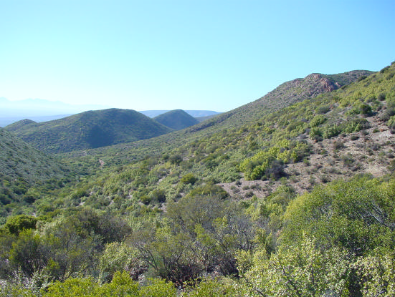
Very High Resolution Remote Sensing of Carbon Stocks in Subtropical Thicket
Dugal Harris¹
Adriaan Van Niekerk²
Jan Vlok³
Mike Powell⁴
Department of Geography & Environmental Studies, Stellenbosch University
Centre for Geographical Analysis, Stellenbosch University
Research Associate, Nelson Mandela Metropolitan University
Department of Environmental Science, Rhodes University
Notes:
Doing masters by research
Avn supervisor
Jan Vlok botanist lot of exp in my study area
0:25

Slide 2
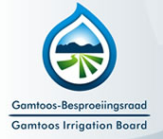




With thanks to
Gamtoos Irrigation Board via the Working for Water Programme for the Department of Environmental Affairs
Notes:
Start with ack
GIB (internship) funding
Help from many other ppl esp in sourcing the imagery
Collaborating Jan Vlok botanist expertise in my study area, does some work in field of spekboom restoration
My supervisor
0:15

Slide 3
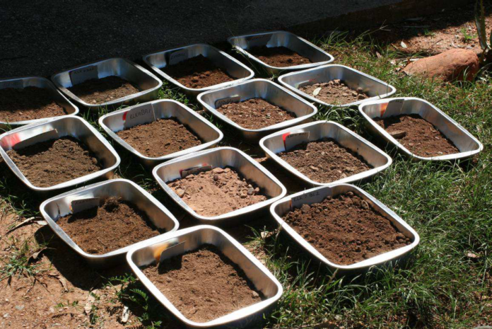
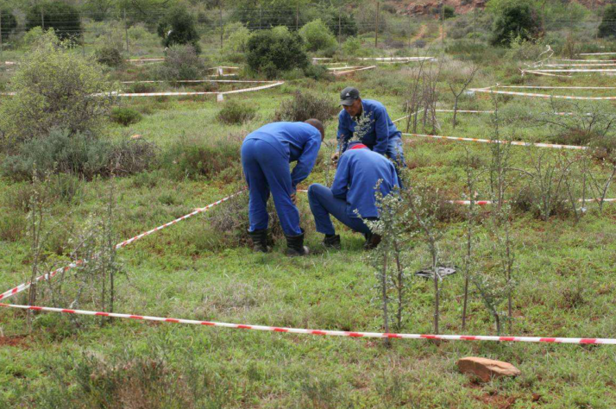
Background
Accurate quantification of carbon stocks is required to trade under schemes such as CDM and VCS.
Manual allometric techniques are not practical over large areas, especially in Subtropical Thicket due to its compositional diversity and complex growth forms.
A Remote Sensing technique is required for mapping carbon stocks at very high resolutions (VHR) (1:10000 map scales) over large areas.
Spekboom canopy cover and carbon stock maps have many other uses including restoration planning and monitoring and deepening the understanding of Subtropical Thicket ecology and carbon cycle.
Source: (Powell 2009)
Notes:
I wanted a research topic that was something practical, with the potential to a real impact: The work is intended to be applied research. Emphasis will be placed on producing maps that are both useful and usable (Pierce et al. 2005). This will require interaction and communication with stake-holders (Knight et al. 2011), specifically environmental practitioners currently involved in thicket restoration, the STRP and the GIB, who are the restoration implementing agents (Mills et al. 2010).
Collabaritive for ecological understanding
Need for VHR: Currently, there is an initiative to involve private land-owners in the restoration project in order to broaden its impact (Curran et al. 2012; Mills et al. 2010). Restoration planning at farm-level will require map scales of 1:10000 or better to provide sufficient spatial detail for working with expected stand sizes of the order of 50 hectares.
Some background on motivation for my research.
Spekboom thicket has been irreversibly degraded by overgrazing throughout its range E Cape and Little Karoo
Active restoration has number of benefits, spekboom acts as nurse plant creates fertile env for other plants to re-est in
Very effective at absorbing CO2, potentially gen income through trading cc’s, improves soil quality, water retention, gen employment
I imagine ppl are quite familiar with situation of spekboom being degraded & lot of interest in restoration.
Canopy cover is a first step towards biomass est from RS
1:10000 translates to ~1m pixel res i.e. VHR imagery
1.50
[Spekboom is very effective at storing carbon compared to other arid region vegetation (Mills et al. 2005).
Spekboom restoration can be funded by trading carbon credits on the international carbon market (Marais, Cowling & Powell 2009).
Restoration helps provide ecosystem services and employment in impoverished areas (Mills & Cowling 2006).
Restoration research and pilot studies are underway.]
Monitoring currently done manually by expert. Subjective, expensive over large areas.

Slide 4
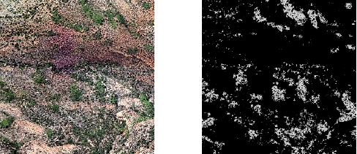
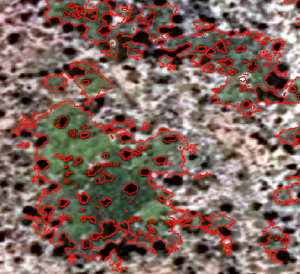
Aim & Objectives
Develop an automated image analysis technique to accurately estimate carbon stocks in Subtropical Thicket, over large areas.
Literature review (carbon stock mapping using VHR imagery).
Source and rectify raw aerial imagery of the study area from NGI. Apply the existing technique for radiometric correction of the NGI aerial imagery.
Conduct a second field study to accurately locate the BNR carbon stock ground truth plots in the aerial imagery.
Using the available BNR carbon stock ground truth, and Spekboom canopy cover mapping technique, develop a regression technique to determine TAGC from aerial imagery. Evaluate and interpret the carbon stock results.
Notes:
Methodology:
While the pixel resolution of the aerial imagery is 0.5m, the positional accuracy (accuracy of orthorectification) may be of the order of 6m, which is typical for commercially available VHR imagery such as WorldView-2 (Satellite Imaging Corporation 2014). Accurate location of the 5x5m carbon stock ground truth plots in the aerial imagery will be problematic with this amount of positional variation. The ground truth plots are demarcated with metal stakes and danger tape but unfortunately the tape is not visible in the aerial imagery. If necessary, high resolution images of the demarcated ground truth plots will be captured in the field to facilitate the accurate location of the plots in the aerial imagery. This would be done by matching surrounding coarse-scale landscape and vegetation features. Field images will be captured using a remotely controlled GoPro camera, suspended from a helium balloon, to achieve a near vertical viewing angle for easier comparison to the aerial imagery.
A multivariate nonlinear regression approach will be adopted to model the relationship between TAGC and features derived from the aerial imagery. A comprehensive set of spectral features, texture features, vegetation indices and secondary measures (such as P. afra canopy cover) will be evaluated for their predictive ability. Given the limited number of 191 ground truth plots, it will be necessary to apply dimensionality reduction and feature selection techniques to reduce the full feature set to an informative minimum. A variety of popular regression models such as random forests and support vector machines will be compared based on their ability to predict TAGC from the derived features. The transferability of models between different habitat types and different levels of degradation will be investigated. Finally, a carbon stock map will be produced for the study area using the available map of habitat types (SANBI 2007) as ancillary information.
In choosing project I wanted something of practical relevance and use.
Suggested to me by Jan Vlok.
NGI only practical option, other ppl produce high res imagery but v expensive.
Too much to cover in one presentation, focus on calibration & leaving out a lot of detail in development of classification
1:30
Academically some aspects of problem make it quite interesting. i.e.
Speak a bit of rationale
1.40

Slide 5
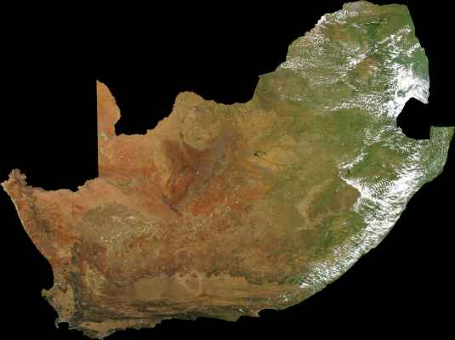
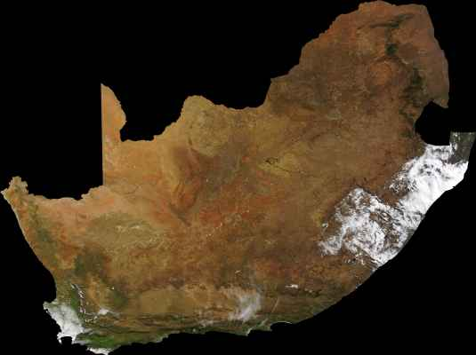
Rationale
Measures of canopy cover can be used to infer biomass.
VHR (0.5m) NGI imagery has not been used for automated vegetation monitoring.
Use of VHR imagery for environmental monitoring of large areas is uncommon.
Arid regions present some remote sensing challenges not typically encountered in forests.
Dealing with sources of unwanted variation.
Notes:
There are a few aspects that make this research interesting from academic perspective.
NGI imagery is freely available, 0.5m res & represents rich source of information which has been under-utilised. Some issues that I will discuss.
Dealing with unwanted sources of variation (temporal, spatial, geological, phenological, habitat etc) is a recurring theme in literature and one of the principal challenges for remote sensing research.
Perhaps just talk to this slide rather than show it. If ppl see lots of text they're going to get bored.
Add MODIS LK images at different times of year / use WAMIS time series viewer
1.30

Slide 6
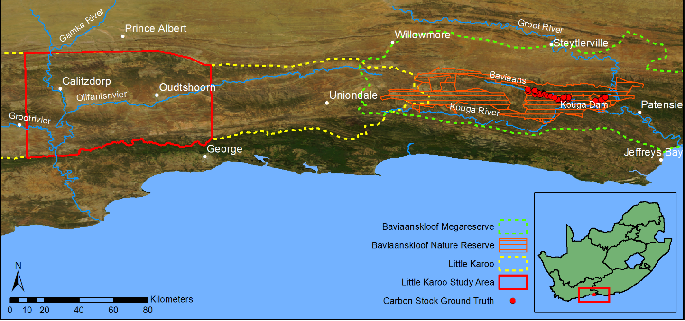
Study Area
Subtropical thicket makes up 35% of the Little Karoo of which roughly 90% is degraded to some extent (Vlok, Cowling & Wolf 2005).
The BNR consists of 19 000 ha of Subtropical Thicket of which 95% is degraded (Powell 2009).
Detailed carbon stock ground truth from Powell (2009) will be invaluable.
Little Karoo vegetation map (Vlok, Cowling & Wolf 2005) also very useful.
Notes:
The Little Karoo is a semi-arid region of great biodiversity lying between two mountain ranges. Three biomes considered to be biodiversity hotspots of global significance intersect in the Little Karoo (Thompson et al. 2009). A total of 54 habitat types were identified by Vlok, Cowling & Wolf (2005) in their vegetation map, of which ten support P. afra. The Subtropical Thicket biome makes up 35.3% of the Little Karoo which has a total area of 2 343 900 ha (Vlok, Cowling & Wolf 2005). It was found that 89.3% of the P. afra thicket was degraded to some extent in a study area comprising roughly half the area of the Little Karoo (Thompson et al. 2009). The Little Karoo was chosen as a study area because it contains a significant portion of P. afra suited and degraded habitat and has been targeted for restoration. It is also beneficial that a number of relevant studies have been performed in the area (Thompson et al. 2009; Forsyth, Vlok & Reyers 2008; Vlok, Cowling & Wolf 2005).
To expedite computing times and reduce storage space required for the VHR imagery, a smaller portion of the Little Karoo was chosen as the study area. This area was chosen to be as representative of the variation in the Little Karoo as possible. It consists of four different aerial survey jobs flown at different times and thus still poses a challenge from a remote sensing perspective. It also includes examples of all the different biomes and nine of the ten habitat types supporting P. afra as defined by Vlok, Cowling & Wolf (2005).
The Baviaanskloof “is arguably one of the most bio diverse areas within Southern Africa with representation of all seven of South Africa’s biomes in the planning domain of the mega-reserve. It is at the convergence of 2 of the world’s top 25 biodiversity hotspots (Cape Floristic Region and the Succulent Karoo). A further biodiversity rich area, the Subtropical Thicket Biome also converges in the area.” (Baviaanskloof Mega-reserve Project 2006: 2) The carbon stock ground truth was restricted to sites within the Baviaanskloof Nature Reserve (BNR) as indicated in Figure 6 2. The BNR consists of 19 000 ha of Subtropical Thicket of which 95% is degraded, making this a suitable restoration area (Powell 2009).
Existing data: Allometric AGC relationships for fourteen common thicket species in the Baviaanskloof Nature Reserve (BNR) were established through the extensive work of Powell (2009) and colleagues. These relationships were used to produce detailed carbon stock ground truth for 191 5x5m grids covering various thicket habitat types and levels of degradation. The availability of this data will be invaluable to the development of an automated remote sensing technique for carbon stock measurement.
Recently have reduced study area as working with imagery for whole of study area was time consuming – give figures – 1 job of calibrated imagery = 400GB
Not practical to test methods on such a large volume of data
Reduced area still presents challenging calibration/classification problem. Methods developed for reduced area will still be applicable to larger area.
Detailed CS ground truth is rare and vital to successful rs studies!!!!
Vegetation maps useful for ground trothing to make sure variability is captured. Also useful for mapping method as it can be used as ancillary data or for different algorithms be applied to different habitat types
0:30
1.45

Slide 7
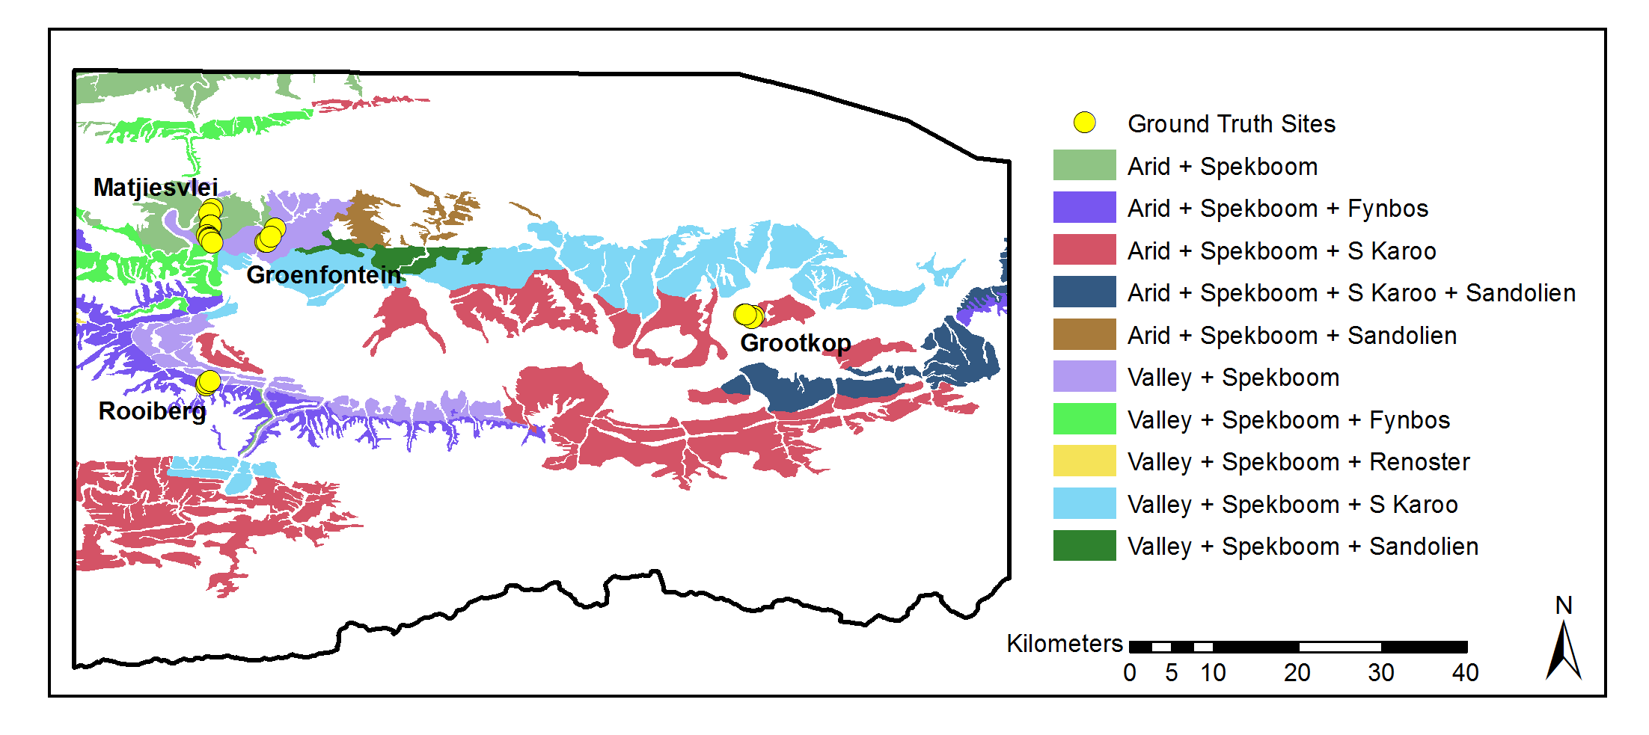
Study Area
Relevant studies have been performed in the area which provide useful ancillary and validation data.
Area was chosen to incorporate as much variation as possible.
Notes:
Degradation mapping study at much coarser res + jv’s veg map
It consists of four different aerial survey jobs flown at different times and thus still poses a challenging calibration problem. 2000 individual images.
It also includes examples of all the different biomes and nine of the ten habitat types supporting Spekboom
0:55
1.45

Slide 8
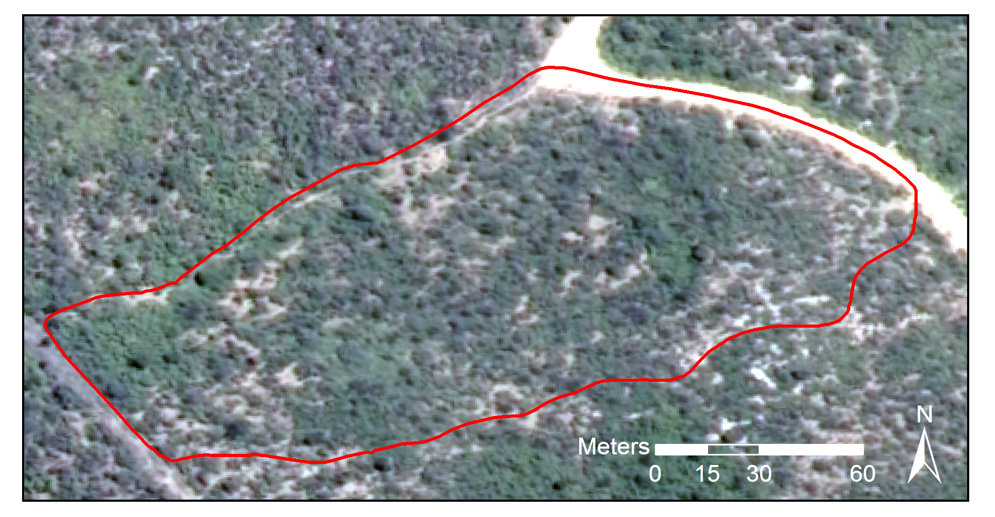
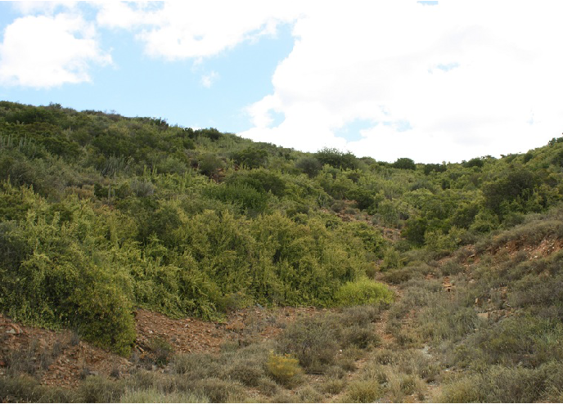
Field Study and Ground Truthing
Ground truthing exercise conducted in collaboration with Jan Vlok.
20 sites of roughly a hectare each were selected to encompass variation in geology, biome and level of degradation.
Boundary polygons were recorded with a DGPS device.
Estimates of canopy cover inside the polygons were established visually and reference photos captured.
Notes:
Departments trimble device
Representative
0:50

Slide 9
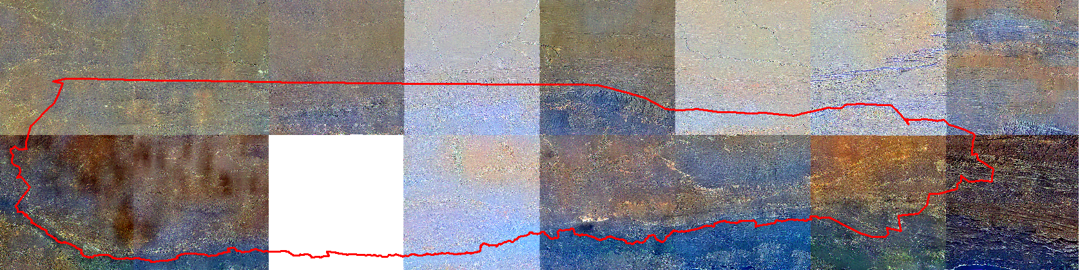
Completed Work: Image Calibration
A novel cross calibration technique for radiometric (colour) correction of aerial images was developed.
Typical mosaic correction methods correct explicitly for mosaic smoothness, atmospheric and BRDF effects.
In our method these corrections are achieved implicitly.
This, in addition to the relative computational speed of the method, makes it an attractive alternative to existing methods.
Notes:
None of the available NGI imagery satisfies the calibration req's
Uses a well-calibrated, concurrent and collocated surface reflectance image to derive a spatially varying linear model which is applied to the aerial images. The calibration method was applied to multi-spectral 0.5m resolution aerial imagery of the study area, using a 500m MODIS NBAR image as reference. The calibrated imagery was validated by comparing it to a SPOT surface reflectance image. The mean absolute reflectance difference was found to be 3.92% which compares favourably to other methods for calibrating aerial image mosaics. Typical mosaic correction methods correct explicitly for mosaic smoothness, atmospheric and BRDF effects. In our method these corrections are achieved implicitly. This, in addition to the relative computational speed of the method, makes it an attractive alternative to existing methods.
0:40
Pre-proc imagery intended for visual interp
Image shows differences between rectified jobs in study area, there are also inconsistencies within jobs
Work to reverse-engineer pre-proc imagery, but not possible
NGI data potentially valuable src of info if calibrated
Pre-proc imagery intended for visual interp
Image shows differences between rectified jobs, there are also inconsistencies within jobs
0:50

Slide 10
Image Calibration
Raw imagery obtained from NGI archives.
Post-processing software obtained from Integraph SA. Corrects for:
Dark current
Sensor non-linearity and non-uniformity
Lens distortion
Misalignment of bands
Relevant camera calibration data obtained from GeoSpace.
Raw imagery has been successfully processed.
Orthorectification applied using aero-triangulation information from NGI.
Notes:
NGI processing damages information in a way that leaves reflectance info unretrievable
Most of my time spent on this
Because none of available formats met calinbration req's I have been working on my own technique
Images show arcmap colour corrected mosiac. Dodging to colour surface based on MODIS image. (“I would guess it is fitting a plane through the colour of the MODIS image and doing a white balance per image on the mosiac to achieve a similar plane for the mosaic but on an average colour per image basis.”)
1.15

Slide 11
Image Calibration
NGI Processed Mosaic
“Raw” Mosaic
Notes:
Correcting for camera effects
The left hand image shows the imagery available from NGI which has had the LUT and dodging applied to it. The right hand image is a mosaic from the recently processed raw imagery. It is apparent that significant colour information has been smoothed or flattened out of the NGI mosaic relative to the raw mosaic. Hopefully the improved colour variance in the raw mosaic will assist in distinguishing P. afra from the background vegetation. One can also see differences in intensity between adjacent images in the raw mosaic. This is due to the images being taken with different exposure times and to BRDF (Bidirectional Reflectance Distribution Function) effects. The BRDF effects can be seen in more detail in Figure 2 which shows a single image that has been intensity stretched. The “hot-spot” reflection from the sun is clearly visible in the bottom left.
1:00

Slide 12
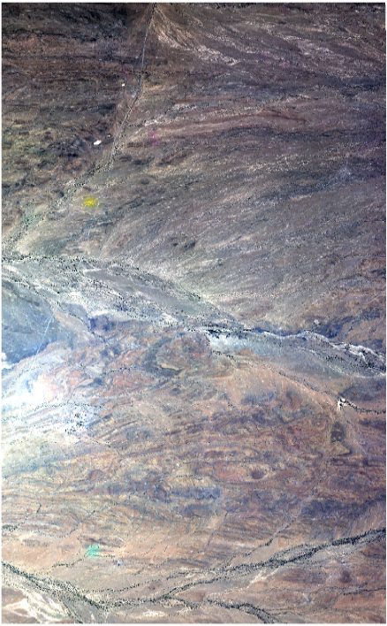

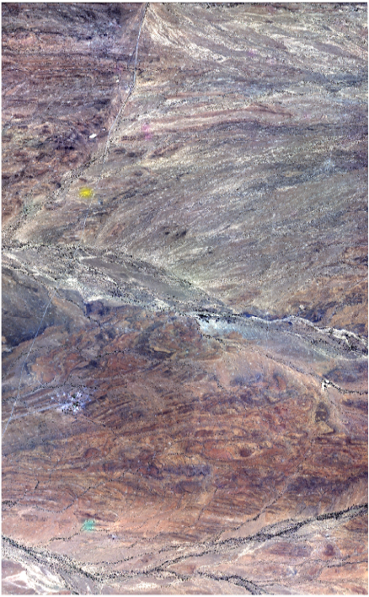
Cross Calibration of VHR mosaics
Radiometric correction for BRDF and atmospheric effects is still required.
Cross calibration uses existing concurrent and collocated surface reflectance image as reference.
Spatially varying linear model found between reference and NGI pixel values.
Complex & time-consuming atmospheric and BRDF corrections are achieved implicitly.
MODIS 500m, 16 day NBAR used as a calibration reference.
Notes:
After correcting for camera effects and orthrectifying, one needs to calibrate for lighting and colour variations. Occur due to viewing geometry and ground cover. BRDF describes how colour of an object or ground cover changes with sun and camera angle. Structurally complex objects like veg can change quite sig with view geom.
And atmospheric correction, scattering, absorption. A lot of my time was spent on this problem.
Existing techniques explicitly correct for BRDF & atmosphere & adjust for continuity between mosaic images. Models, assumptions, complexities, time-consuming optimisation, sometimes vicarious calib, real spectral meas on ground.
Existing tech’s were not favoured due to time & complex theoretical models of BRDF and impossibility of vicarious meas so we devised our own tech based on concept of X Calib which instead of models or BRDF etc uses known well calibrated ref ,.
Spatially varying lin model fitted betw this and aerial images and applied to aerial images. Model is much lower res than NGI, assumed BRDF etc change slowly.
This way only adjustment is lin model which is simple to fit. BRDF & atmospheric correction achieved implicitly.
Images show raw on left with hot spot, refl of sun eg of BRDF effect. Pure gain linear model, middle image shows gains. Rh image is calibrated image which is product of first 2 images
2:40
Kind of data fusion where data at different spatial scales is being fused. Calibration methods for ref are well established and validated.
BRDF can be thought of as reflection of sun from ground cover, varies with sun and camera angle for different ground covers.
1:25
Nadir BRDF description
In progress
Downsample NGI to match MODIS, spatially varying grid of calib coeff, upsample and smooth, then apply to NGI
Check my desc of theory
Theoretical concerns: difference in spatial res (assumes large pixel = sum small pixels), spectral chars

Slide 13
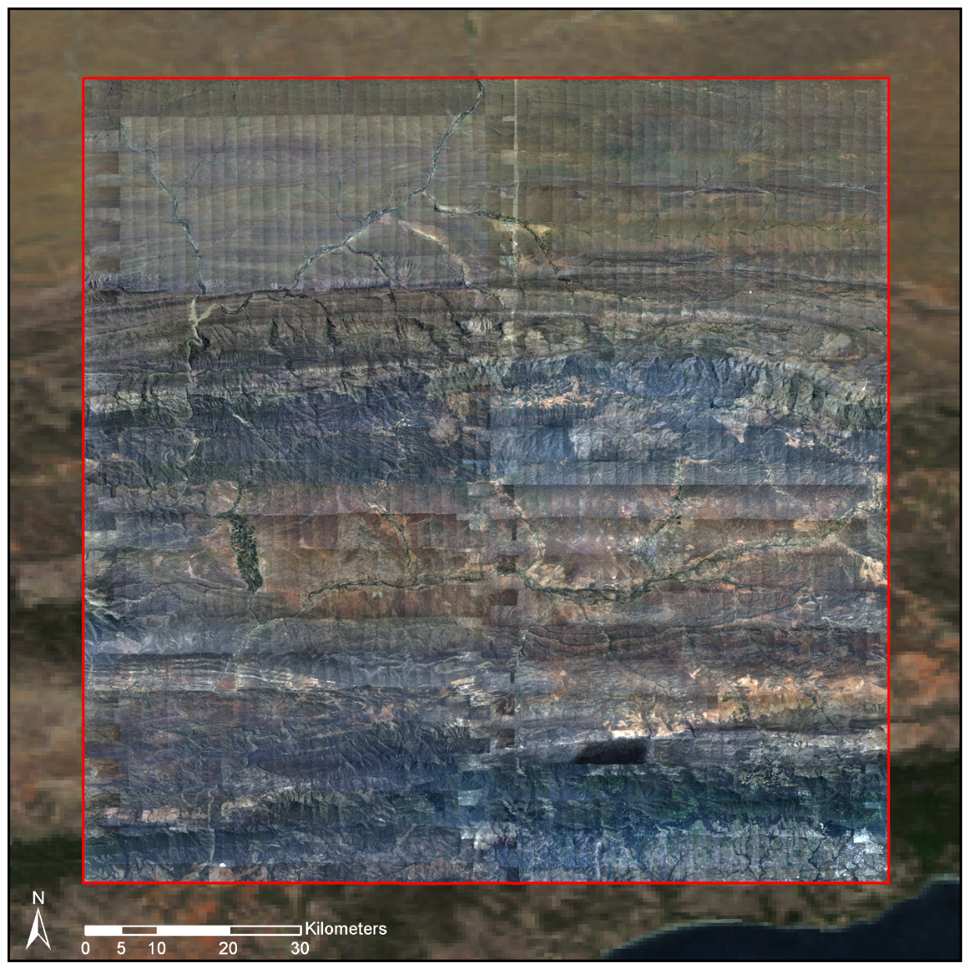
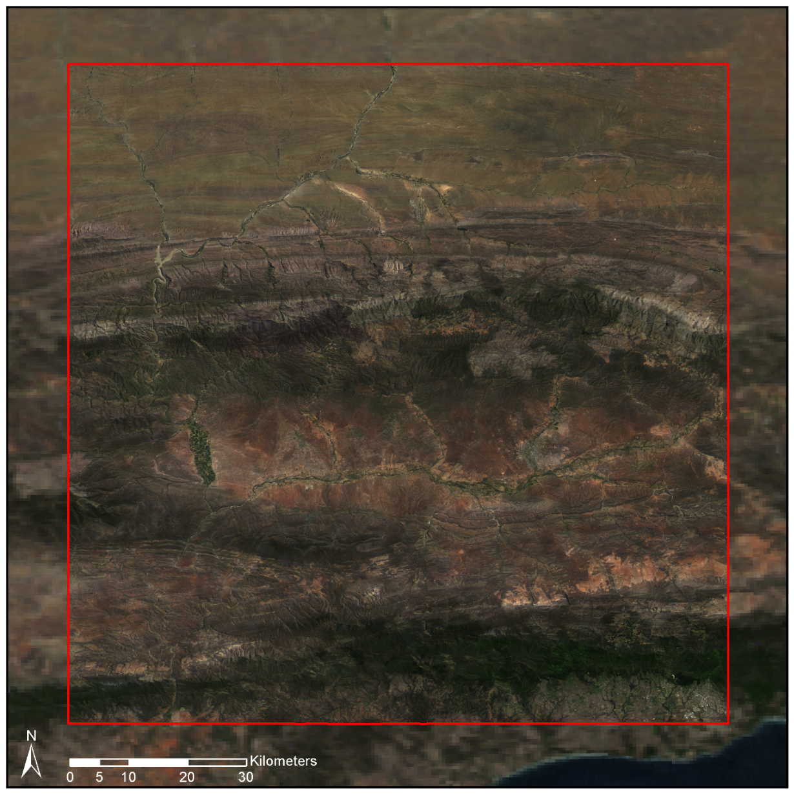
Cross Calibration –Source
Notes:
Results
Shows uncalibrated source NGI ims against MODIS background
Notice hot spot & intensity variations within images. Discontinuities between images and between images and MODIS reference/background
0:30

Slide 14
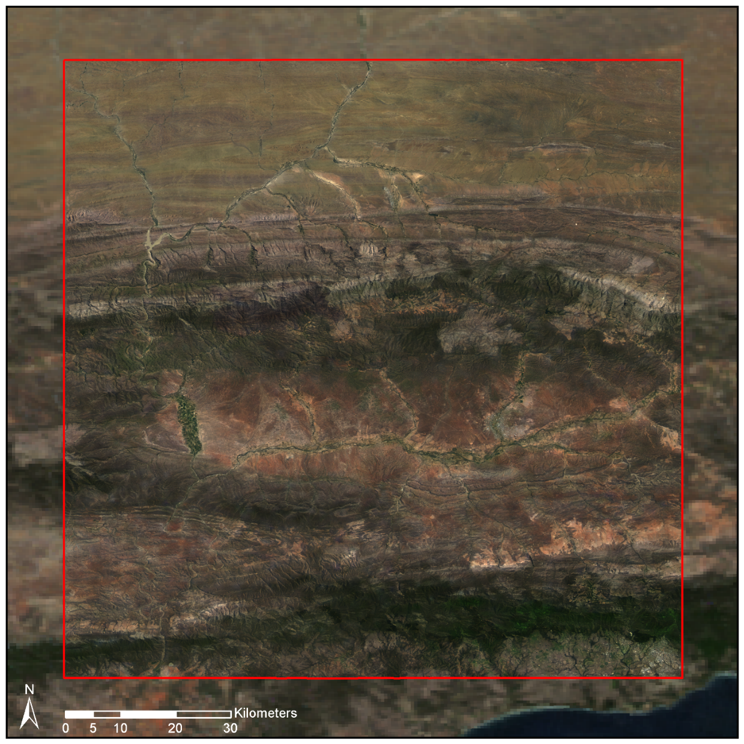
Cross Calibration – Corrected
Notes:
Shows calibrated mosaic of ~2000ims against modis ref. Mosaic smooth and matches well with MODIS bg.
0:30

Slide 15
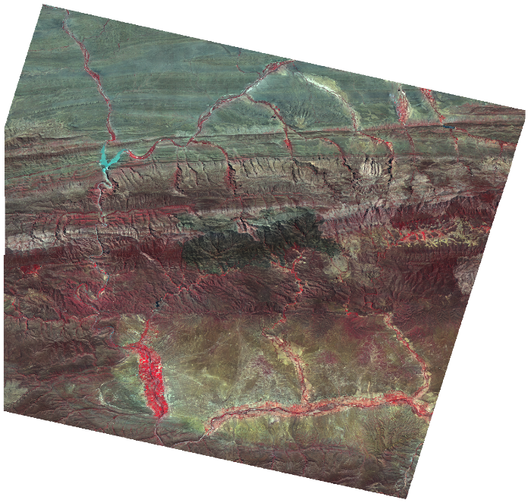
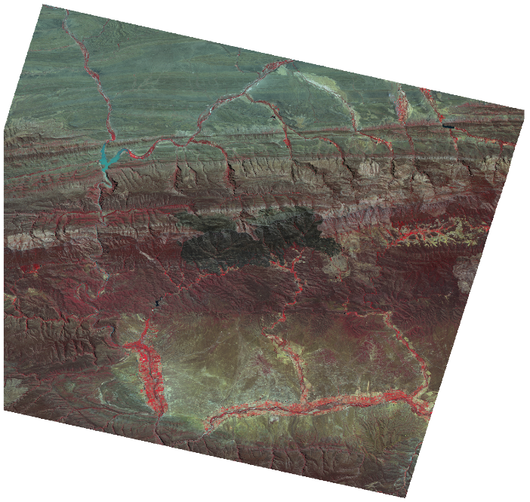
Cross Calibration – Validation
Comparison with SPOT surface reflectance gave mean absolute error of 3.92%
NGI Calibrated Mosaic
SPOT Surface Reflectance
Notes:
Comparison, colour-infrared NGI mosaic to concurrent SPOT surface refl. Very similar. Considering simplicity of method is very good result, better than other est methods.
Quantitative rs on eerial imagery of large scales still fairly uncommon mainly due to calibration issues, methods struggle to generalise over spatial/temporal, recurring theme in rs
Hope this will help open up NGI imagery to other rs, as it is valuable source of info that has been underutilised
1:00

Slide 16
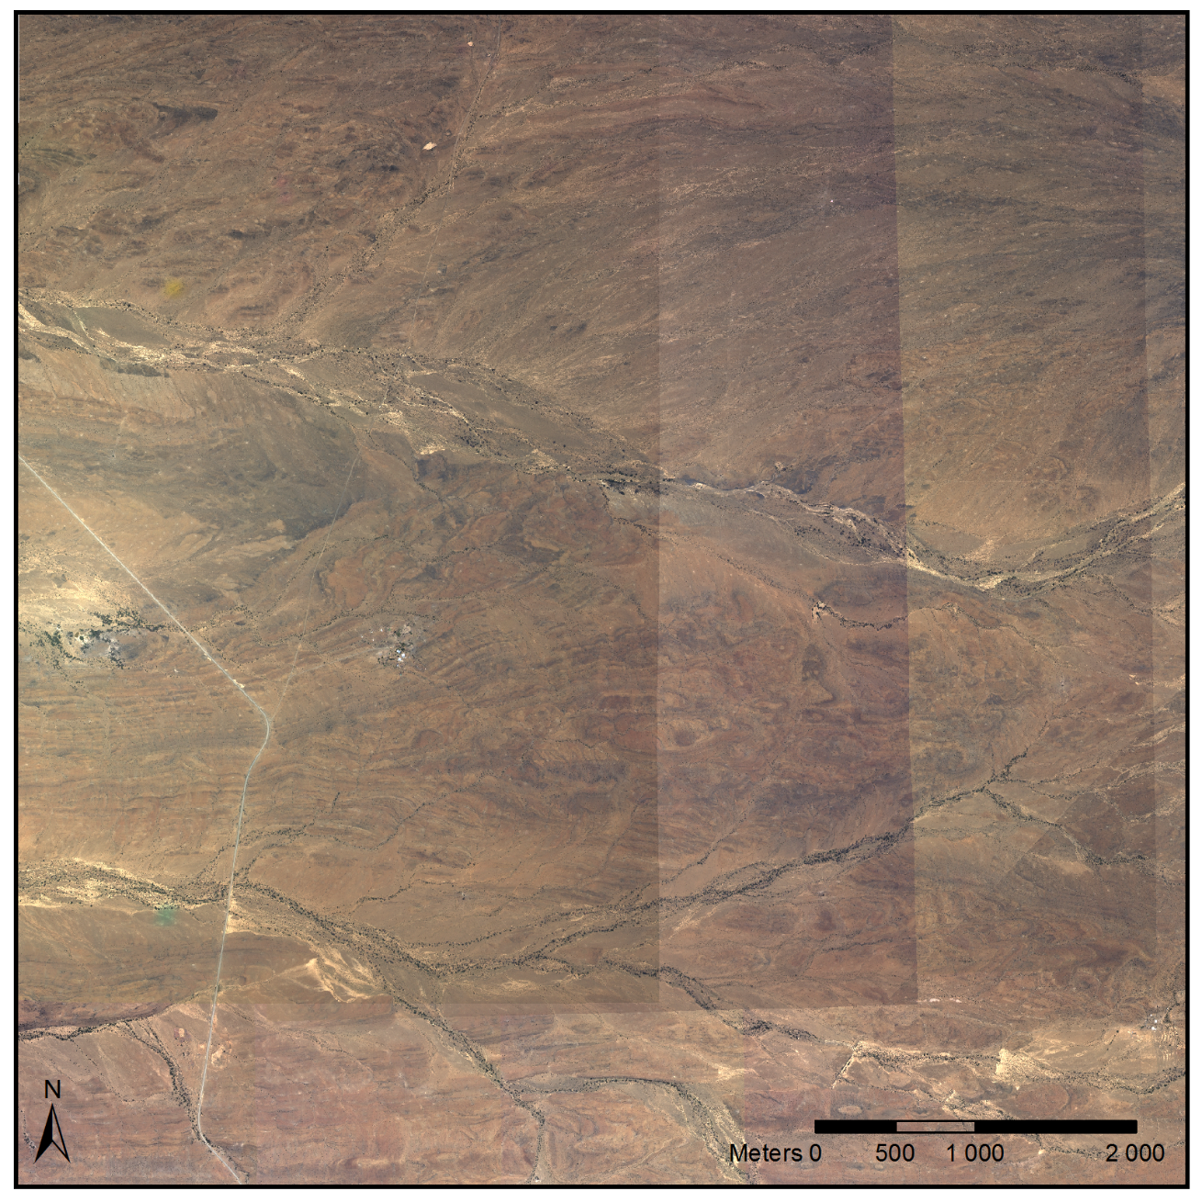
Cross Calibration:
Hot-spots and Seam Lines
NGI Uncalibrated Close-Up
Notes:
Bright spot is hot spot, refl of sun that happens in certain terrains. Not real and eg of BRDF.

Slide 17
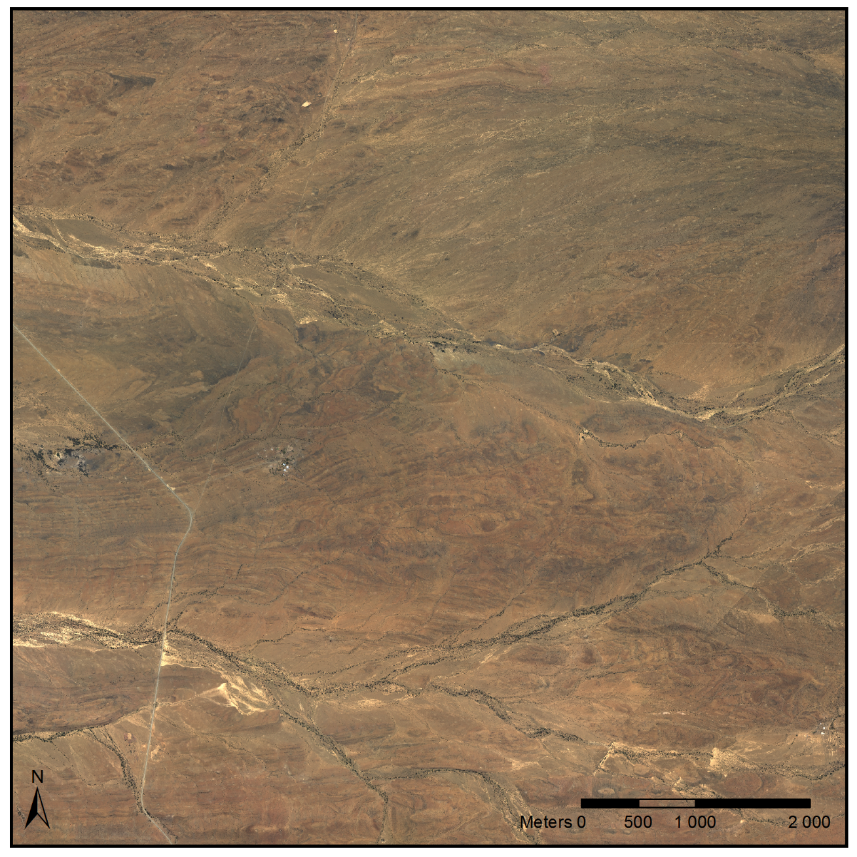
Cross Calibration:
Hot-spots and Seam Lines
NGI Calibrated Close-Up
Notes:
:45

Slide 18
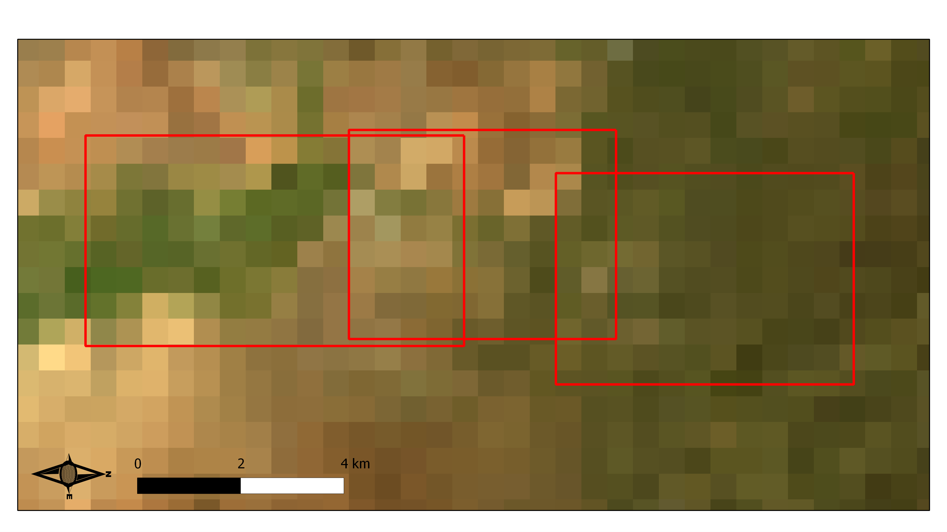
Cross Calibration – MODIS reference
Notes:
Coarse resolution in comparison to NGI is a concern.
Practically BRDF adjustments can only be made at coarse scale.
MODIS provides daily, free source of imagery with roughly matching spectral chars to NGI and well established calib method.
0:30

Slide 19
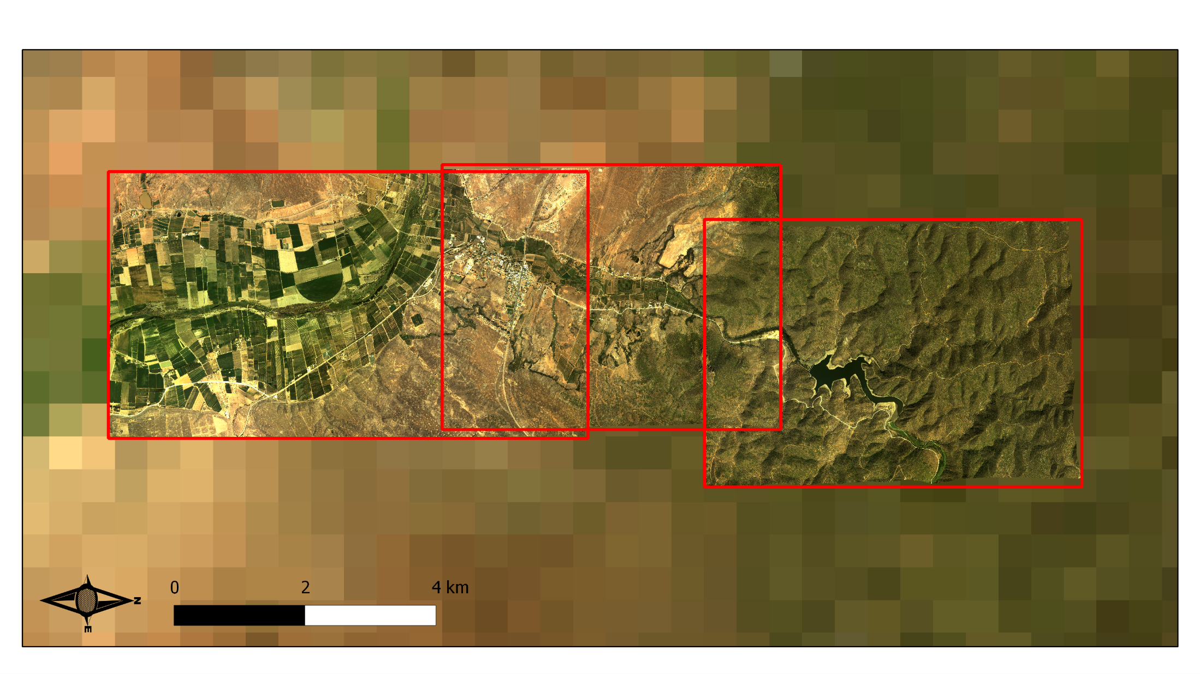
Cross Calibration – NGI Calibrated
Notes:
Inter (BRDF, sun spot) and intra (exposure, BRDF) scene variances compensated for.
Within and between scene inconsistencies compensated for. Good colour match to MODIS ref in background.
Results look visually quite good. Work remains to automate and test this process. I have some concerns around theoretical validity of this approach. So while results look good, they need testing.
0:50

Slide 20
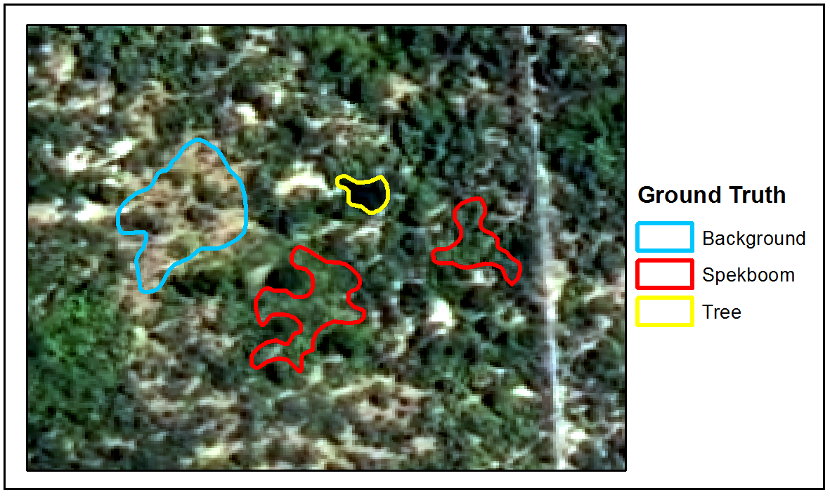
Classification
Ground truth data established by hand-labelling polygons.
46 spectral, textural and vegetation index features were evaluated.
A method of selecting features in the presence of correlation was developed and used to select a reduced set of 6 informative features.
A number of classifiers (KNN, normal Bayes, SVM, random forest, decision tree) were evaluated.
Decision tree selected as it achieved best results on field ground truth and was the second fastest
Notes:
Supervised classification, ground truth for training
Found traditional fs was sensitive to correlation amongst features, devised a way that was robust to this
All clfrs performed similarly, suggesting good features
Processing times are long for VHR imagery so a lot of emphasis was placed computational speed in features that were used and classifier
1:40
Wanted an idea if imagery calibrated would it be possible to classify spekboom.
1:20

Slide 21
Classification - Results
 | Background | Spekboom | Total | PA (%)ª
Background | 30103 | 514 | 30617 | 98.32
Spekboom | 1491 | 25769 | 27260 | 94.53
Total | 31594 | 26283 | 57877
CA (%)ª | 95.28 | 98.04
Kappa | 0.93
Overall Error (%) | 3.57
Area | Num. | Ground Truth (%) | Classifier (%) | Expert (%)
Groenfontein | 1 | 0.00 | 0.07 | 1.50
 | 2 | 4.00 | 0.47 | 11.00
 | 3 | 10.00 | 8.21 | 20.00
 | 4 | 25.00 | 17.44 | 27.50
Matjiesvlei | 1a | 6.00 | 7.21 | 20.00
 | 1b | 22.50 | 31.37 | 52.50
 | 2 | 70.00 | 67.38 | 87.50
 | 3 | 85.00 | 73.12 | 90.00
 | 4 | 65.00 | 70.34 | 95.00
 | 5 | 37.50 | 35.95 | 87.50
 | 6 | 17.50 | 12.01 | 77.50
 | 7 | 15.00 | 25.74 | 87.50
 | 8 | 2.00 | 5.42 | 20.00
Rooiberg | 1 | 20.00 | 6.03 | 27.50
 | 2 | 11.00 | 1.03 | 5.05
 | 3 | 0.00 | 0.00 | 1.01
Grootkop | 1 | 22.50 | 8.05 | 20.00
 | 2 | 0.50 | 0.22 | 0.51
 | 3 | 42.50 | 34.38 | 57.50
 | 4 | 77.50 | 71.27 | 77.50
MAE (SAE)ª |  |  | 5.85% (4.65%) | 17.50% (20.98%)
Notes:
Performance on image ground truth extremely good – 3.57% overall error.
Performance on field ground truth good – 5.85%. Tendency to overest in densely veg areas and underest in more arid / degraded areas. But accurate and useful nevertheless.
Clfr beats expert estimates from images. All things considered, I’m very happy with these results.
1:20
Some error present in ground truth itself as was an estimate,
Difference in error suggests image ground truth not that repr of field ground truth. Not v surprising as image areas were chosen where certainty as to class which means more challenging eg’s omitted .

Slide 22
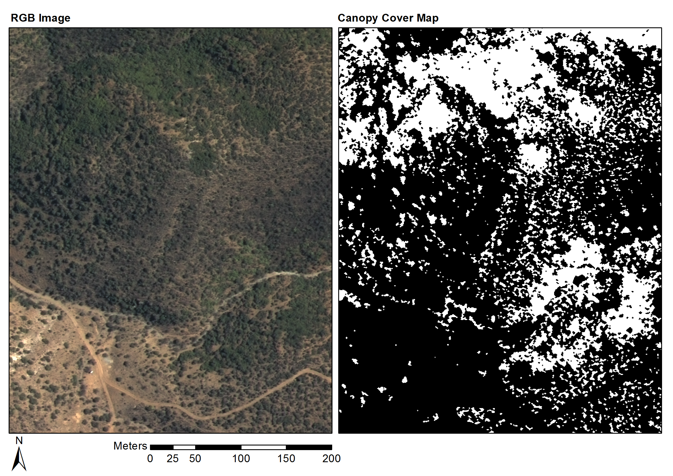
Classification - Results
Notes:
Figure show example results.
RH images display prob that a pix is Spekboom (white = 100% prob, black 0%). Have checked with Jan Vlok that these images are Spekboom thicket
60

Slide 23
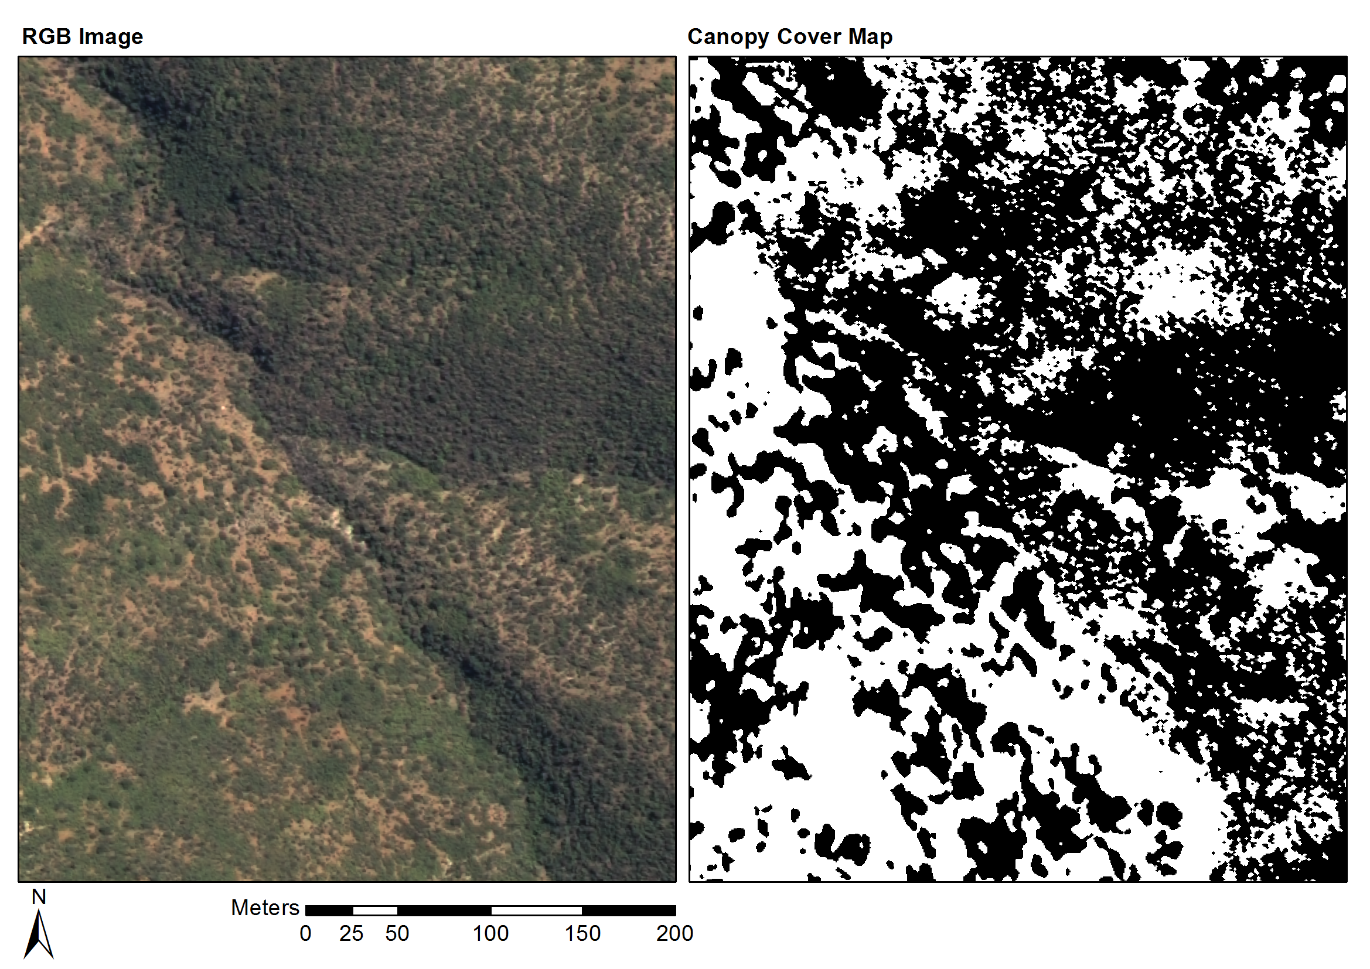
Classification - Results

Slide 24
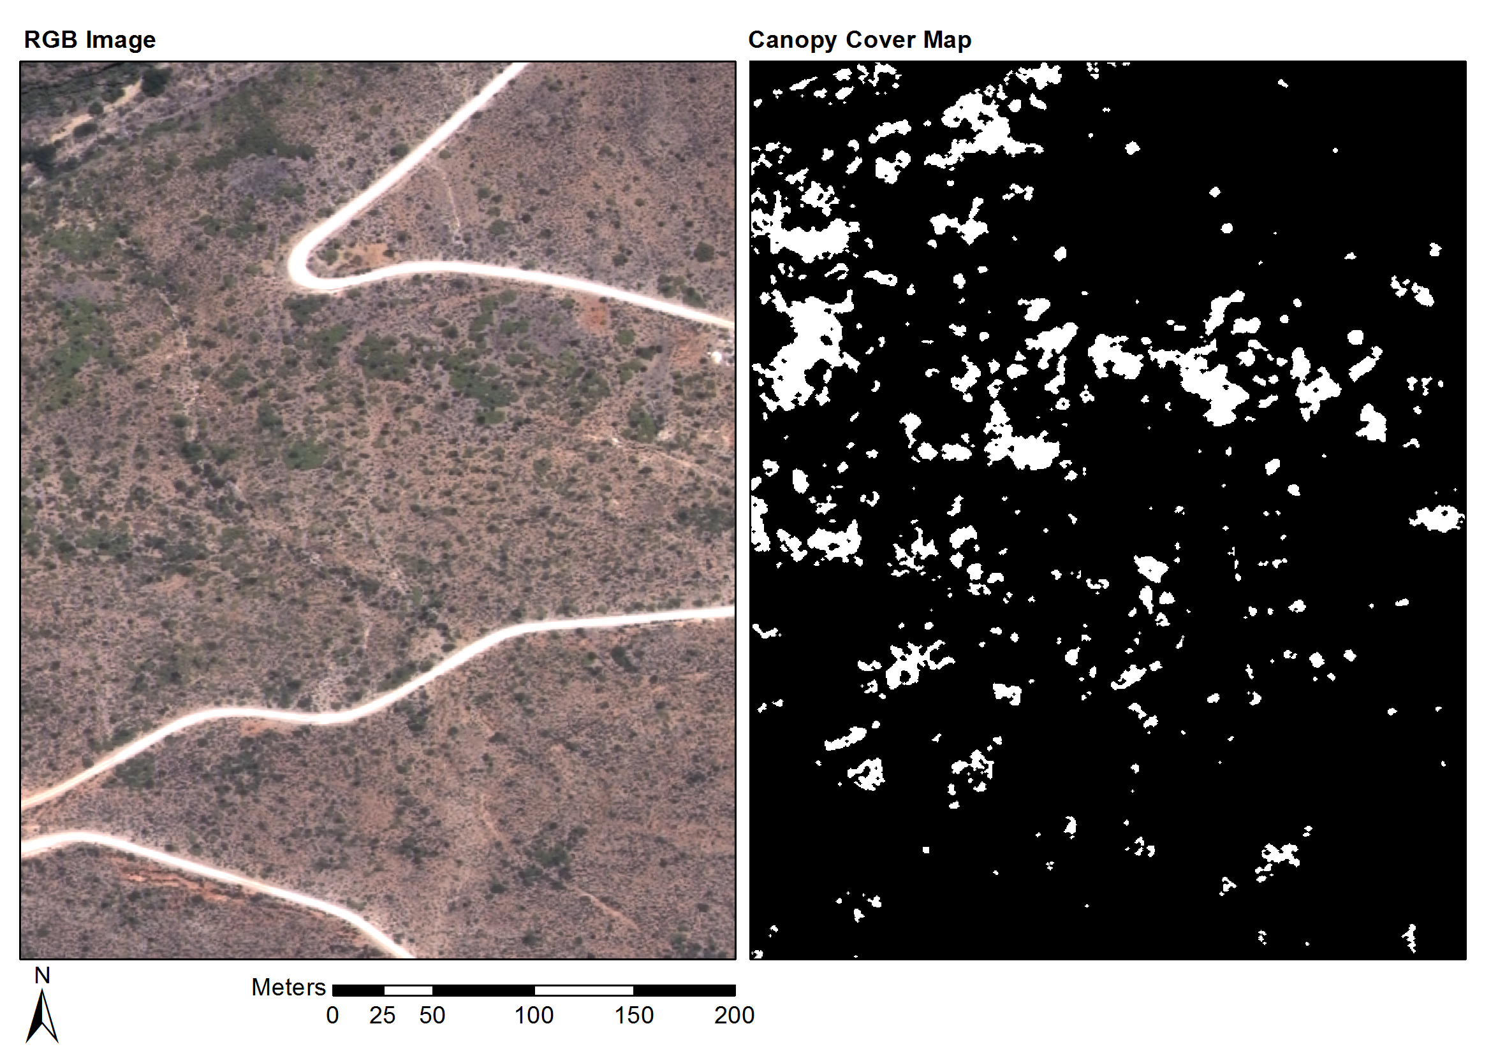
Classification - Results
Notes:
Fynbos mosaic area, prev farm quite degraded
Figure show example results. RH images display prob that a pix is Spekboom (white = 100% prob, black 0%). Have checked with Jan Vlok that these images are Spekboom thicket
0:50

Slide 25
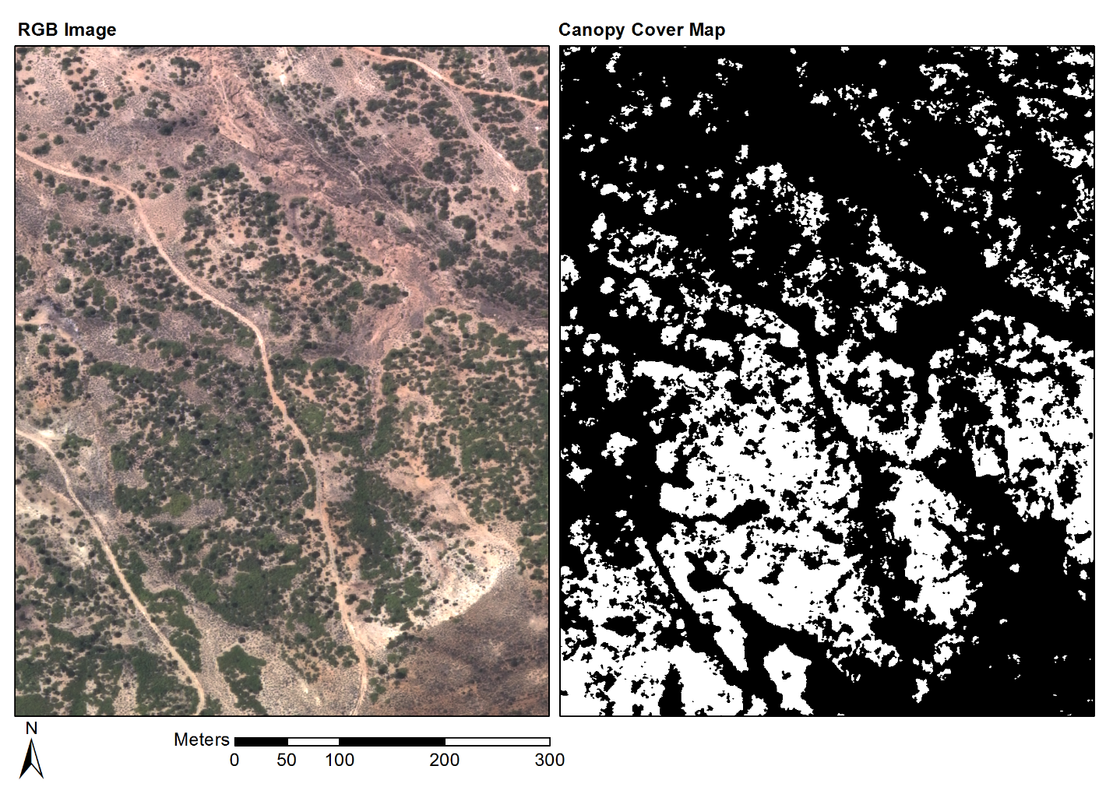
Classification - Results
Notes:
Succ. Karoo mosaic. Close to Oudtshoorn, parts quite degraded, .

Slide 26
Classification
Classification Close-up
Notes:
Close-up showing boundary of classified area.
Dark blobs are Euclea and Pappea trees and should be excluded
Ha

Slide 27
Discussion
Successful Spekboom canopy cover map is an important step to remote sensing of carbon stocks. Powell (2009) found that Spekboom canopy cover was correlated with TAGC (R²=0.52).
A free source of normally costly VHR imagery is available via NGI. Having a working calibration method for this imagery opens up a lot of possibilities.
The available detailed ground truth and foundation of existing restoration research are seldom available in remote sensing research.
Having all these important resources in place, puts us in a good position to develop a robust, accurate carbon stock mapping technique.
Notes:
Canopy cover recognised as an important predictor of biomass
Nevertheless, commercial imagery has IR detail that would be of interest: pricing?? WorldView-2 8 band 0.5m orthorectified imagery (110km2 @ R293.66/km2 ) R 32,303.04
Dealing with sources of unwanted variation is a recurring difficulty reported in the remote sensing literature (Eisfelder, Kuenzer & Dech 2012; Baraldi et al. 2010; Lu 2006). My/”our” calibration is good start to dealing with this.
Methodology:
While the pixel resolution of the aerial imagery is 0.5m, the positional accuracy (accuracy of orthorectification) may be of the order of 6m, which is typical for commercially available VHR imagery such as WorldView-2 (Satellite Imaging Corporation 2014). Accurate location of the 5x5m carbon stock ground truth plots in the aerial imagery will be problematic with this amount of positional variation. The ground truth plots are demarcated with metal stakes and danger tape but unfortunately the tape is not visible in the aerial imagery. If necessary, high resolution images of the demarcated ground truth plots will be captured in the field to facilitate the accurate location of the plots in the aerial imagery. This would be done by matching surrounding coarse-scale landscape and vegetation features. Field images will be captured using a remotely controlled GoPro camera, suspended from a helium balloon, to achieve a near vertical viewing angle for easier comparison to the aerial imagery.
A multivariate nonlinear regression approach will be adopted to model the relationship between TAGC and features derived from the aerial imagery. A comprehensive set of spectral features, texture features, vegetation indices and secondary measures (such as P. afra canopy cover) will be evaluated for their predictive ability. Given the limited number of 191 ground truth plots, it will be necessary to apply dimensionality reduction and feature selection techniques to reduce the full feature set to an informative minimum. A variety of popular regression models such as random forests and support vector machines will be compared based on their ability to predict TAGC from the derived features. The transferability of models between different habitat types and different levels of degradation will be investigated. Finally, a carbon stock map will be produced for the study area using the available map of habitat types (SANBI 2007) as ancillary information.

Slide 28
References
Eisfelder C, Kuenzer C & Dech S 2012. Derivation of biomass information for semi-arid areas using remote-sensing data. International Journal of Remote Sensing 33 (9): 2937–2984.
Forsyth G, Vlok J & Reyers B 2008. Retention and restoration of the biodiversity of the Little Karoo. CSIR Report No CSIR/NRE/ECO/ER/2008/0118/C. Critical Ecosystem Partnership Fund, CSIR.
Lu D 2006. The potential and challenge of remote sensing based biomass estimation. International Journal of Remote Sensing 27 (7): 1297-1328.
Marais C, Cowling RM & Powell M 2009. Establishing the platform for a carbon sequestration market in South Africa: The Working for Woodlands Subtropical Thicket Restoration Programme. In XIII World Forestry Congress, 1-13. Buenos Aires, Argentina.
Mills AJ, Cowling RM, Fey M, Kerley G, Donaldson J, Sigwela A, Skowno A & Rundel P 2005. Effects of goat pastoralism on ecosystem carbon storage in semiarid thicket , Eastern Cape , South Africa. Austral Ecology 30: 797-804.
Mills AJ & Cowling RM 2006. Rate of carbon sequestration at two thicket restoration sites in the Eastern Cape, South Africa. Restoration Ecology 14 (1): 38-49.
Thompson M, Vlok J, Rouget M, Hoffman MT & Cowling RM 2009. Mapping grazing-induced degradation in a semi-arid environment: A rapid and cost effective approach for assessment and monitoring. Environmental Management 43: 585-596.
Vlok J, Cowling RM & Wolf T 2005. A vegetation map for the Little Karoo. Unpublished maps and report for a SKEP project supported by CEPF grant no 1064410304.
Chandelier L, & Martinoty G 2009. A radiometric aerial triangulation for the equalization of digital aerial images and orthoimages. Photogrammetric Engineering & Remote Sensing 75(2), 193–200.
Collings S, Caccetta P, Campbell N & Wu X 2011. Empirical models for radiometric calibration of digital aerial frame mosaics. IEEE Transactions on Geoscience and Remote Sensing 49(7), 2573–2588.
Jain A, Duin R, & Mao J 2000. Statistical pattern recognition : A review. IEEE Transactions on Pattern Analysis and Machine Intelligence, 22(1), 4–37.
Jiang G-M & Li Z-L 2009. Cross-calibration of MSG1-SEVIRI infrared channels with Terra-MODIS channels. International Journal of Remote Sensing 30(3), 753–769.
Li L, Yang J & Wang Y 2012. Cross-calibration of HJ-1B/CCD1 image based on Aqua/MODIS data. 2012 Second International Workshop on Earth Observation and Remote Sensing Applications, 1–4.
Strahler A 1999 MODIS BRDF Albedo Product : Algorithm Theoretical Basis Document, 1–53.
Eisfelder C, Kuenzer C & Dech S 2012. Derivation of biomass information for semi-arid areas using remote-sensing data. International Journal of Remote Sensing 33 (9): 2937–2984.
Notes:
Mostly new calib references

Slide 29
Questions?

